Slide 1
PROJECT MANAGEMENT COST

Slide 2
CONTENTS
Meaning of Cost & project cost management
Process of project cost management
Resources Planning
Cost Estimating
Cost Budgeting
Cost Control

Slide 3
What is cost and project cost management
Cost Refer the resources used to make a product expressed in monetary term.
Project cost management includes the processes required to ensure that the project is completed within an approved budget.

Slide 4
Project cost management process
Resource planning: determining what resources and quantities of them should be used.
Cost estimating: developing an estimate of the costs and resources needed to complete a project.
Cost budgeting: allocating the overall cost estimate to individual work items to establish a baseline for measuring performance.
Cost control: controlling changes to the project budget.

Slide 5
Basic Principles of Cost Management
Most CEOs and boards know a lot more about finance than IT, so IT project managers must speak their language
Profits are revenues minus expenses
Life cycle costing is estimating the cost of a project plus the maintenance costs of the products it produces
Cash flow analysis is determining the estimated annual costs and benefits for a project
Benefits and costs can be tangible or intangible, direct or indirect
Sunk cost should not be a criteria in project selection

Slide 6
Resources planning
The nature of the project and the organization will affect resource planning
Some questions to consider:
How difficult will it be to do specific tasks on the project?
Is there anything unique in this project’s scope statement that will affect resources?
What is the organization’s history in doing similar tasks?
Does the organization have or can they acquire the people, equipment, and materials that are capable and available for performing the work?

Slide 7
Cost Estimating
It is important to develop a cost management plan that describes how cost variances will be managed on the project.
An important output of project cost management is a cost estimate.
There are several types of cost estimates, tools and techniques to help create them.

Slide 8
Types of Cost Estimates

Slide 9
Cost Estimation Tools and Techniques
There are 3 basic tools and techniques for cost estimates:
analogous or top-down: use the actual cost of a previous, similar project as the basis for the new estimate.
bottom-up: estimate individual work items and sum them to get a total estimate.
parametric: use project characteristics in a mathematical model to estimate costs. (e.g. Constructive Cost Model (COCOMO)).

Slide 10
Problem facing IT Cost Estimates
Developing an estimate for a large software project is a complex task requiring a significant amount of effort. Remember that estimates are done at various stages of the project.
Many people doing estimates have little experience doing them. Try to provide training and mentoring
People have a bias toward underestimation. Review estimates and ask important questions to make sure estimates are not biased
Management wants a number for a bid, not a real estimate. Project managers must negotiate with project sponsors to create realistic cost estimates

Slide 11
Cost Budgeting
Cost budgeting involves allocating the project cost estimate to individual work items and providing a cost baseline.
The WBS is required input to the cost budgeting process since it defines the work items.
Important goal is to produce a cost baseline.

Slide 12
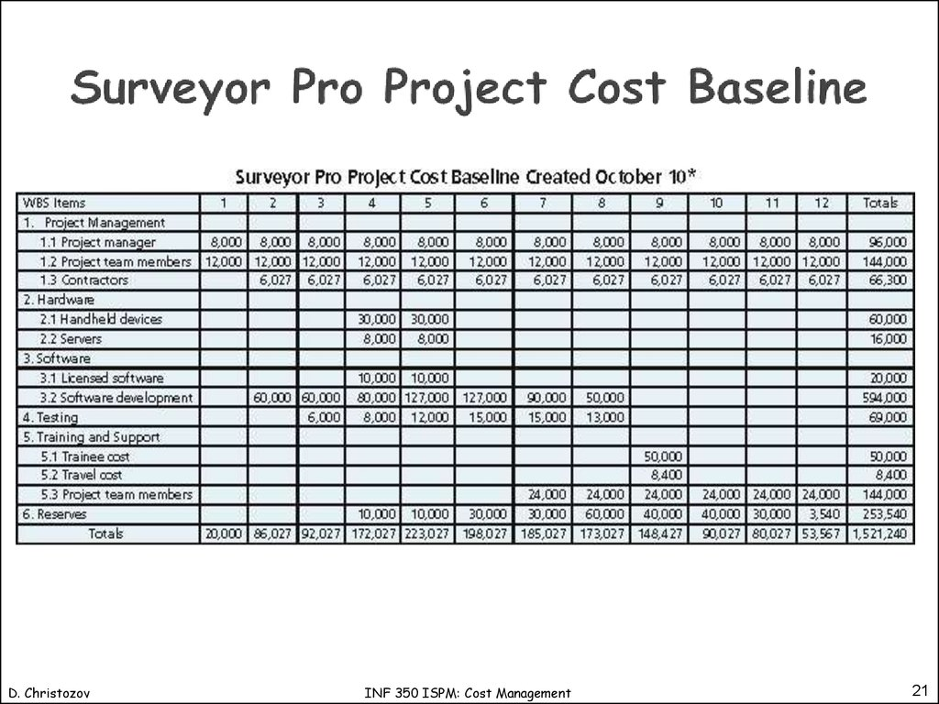

Slide 13
Cost control
Project cost control includes:
monitoring cost performance.
ensuring that only appropriate project changes are included in a revised cost baseline.
informing project stakeholders of authorized changes to the project that will affect costs.
Earned value management is an important tool for cost control.

Slide 14
Earning Value Management (EVM)
The planned value (PV), formerly called the budgeted cost of work scheduled (BCWS), also called the budget, is that portion of the approved total cost estimate planned to be spent on an activity during a given period
Actual cost (AC), formerly called actual cost of work performed (ACWP), is the total of direct and indirect costs incurred in accomplishing work on an activity during a given period
The earned value (EV), formerly called the budgeted cost of work performed (BCWP), is an estimate of the value of the physical work actually completed

Slide 15
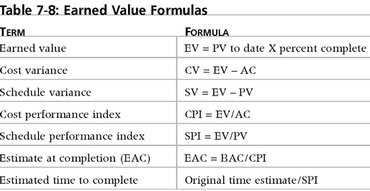
Earned Value Formulas

Slide 16
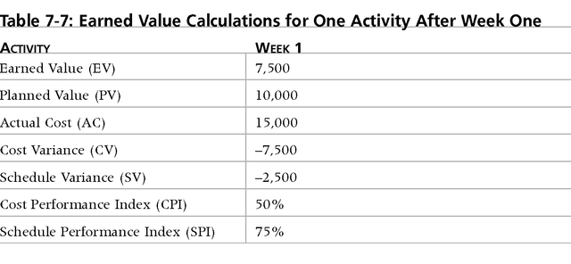
CV = 7500-15000 = -7500
SV = 7500-10000 = -2500
CPI = 7500/15000 = 50%
SPI = 7500/10000 = 75%

Slide 17
Rules on Earned Value Numbers
Negative numbers for cost and schedule variance indicate problems in those areas. Negative numbers mean the project is costing more than planned or taking longer than planned.
CPI and SPI less than 100% indicate problems.

Slide 18
THANK YOU

